Slide 1
Pittsburgh Lighting Analysis
By SoftLights.org

Slide 2
“I have serious issues with glare and flare from LED lights which are too bright. It is so bad for me that it is a dangerous situation when I am driving in areas where the lights are too intense.” – Pittsburgh resident.

Slide 3
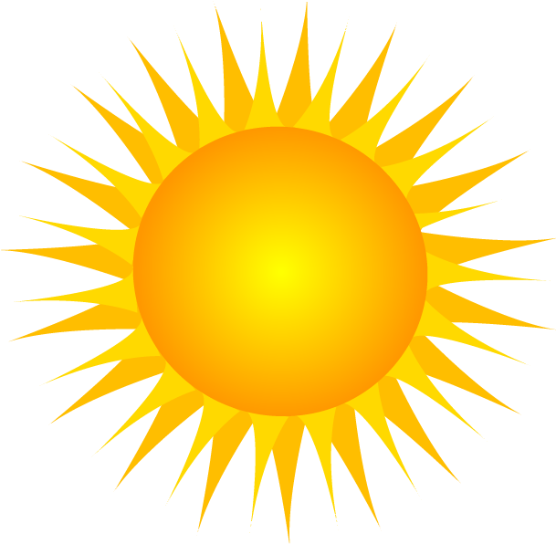
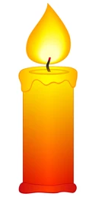
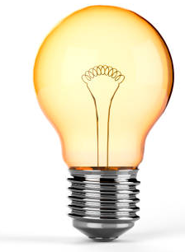
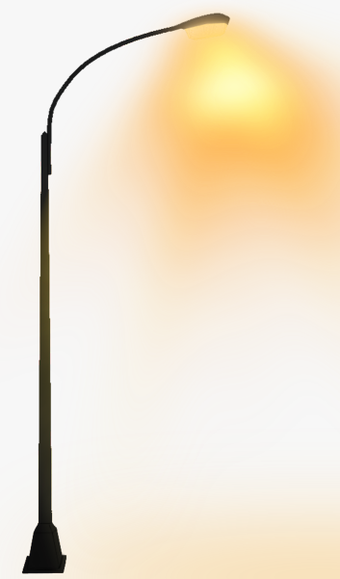
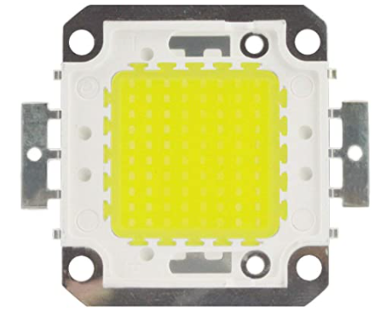

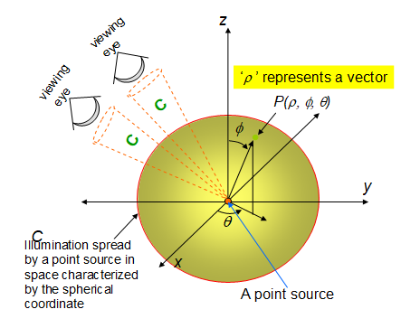
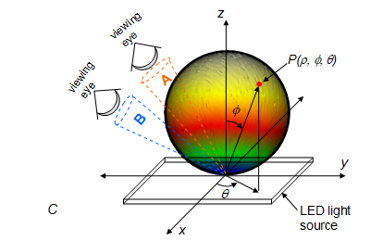
Spherical vs. Flat Emitter
sun
candle
incandescent
laser
gas-discharge
LED
Spherical Emitter – point source
Flat Emitter – Lambertian source

Slide 4
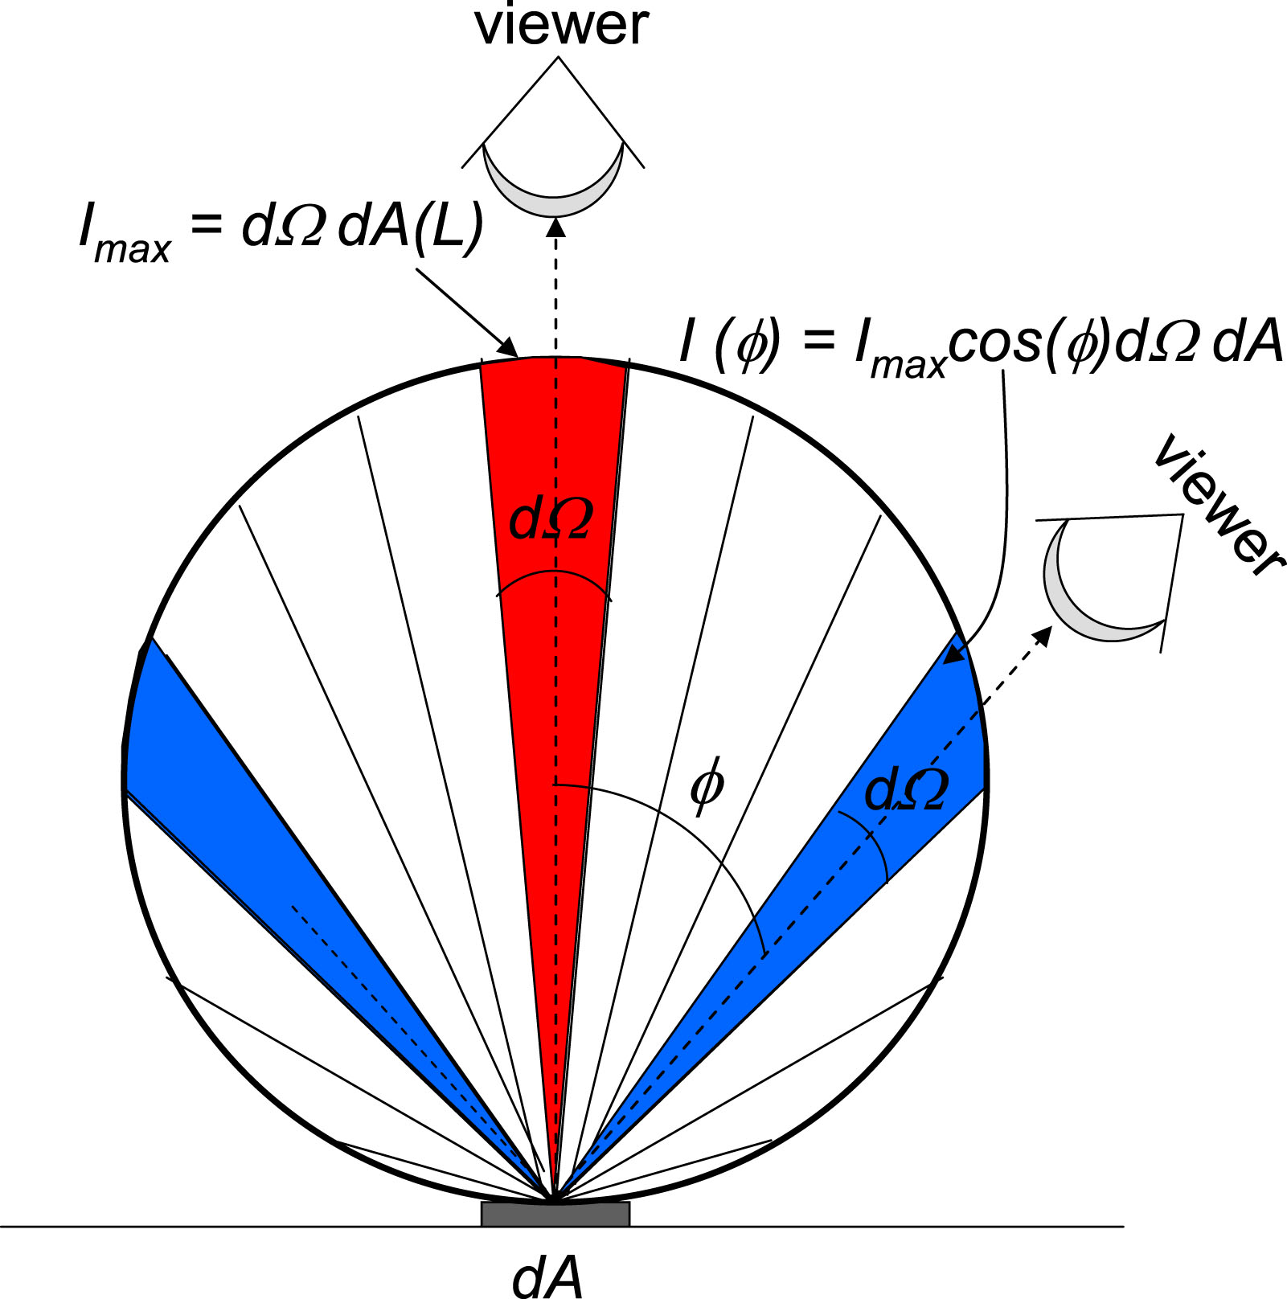
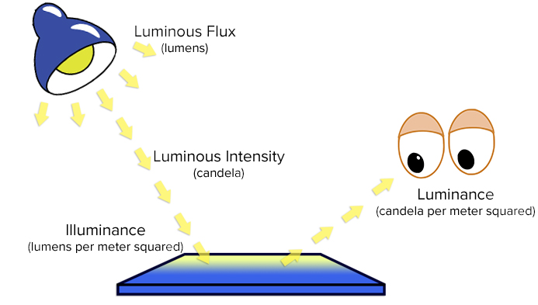
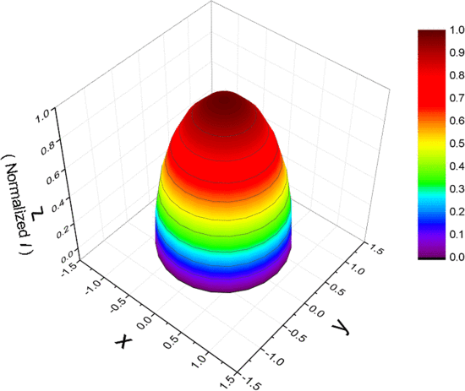
Luminance
Uniform Luminance
Non-uniform Luminance

Slide 5
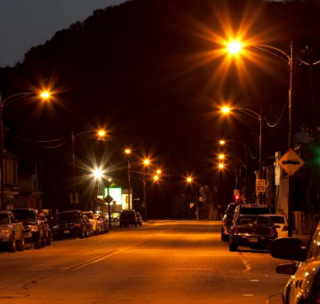
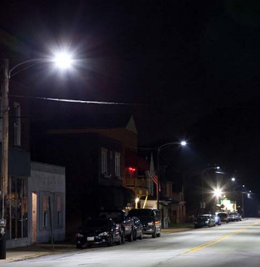
HPS v. LED
High Pressure Sodium
Light Emitting Diode
Safer? Protecting Natural Night? Calmer? More Stars? Less Glare?

Slide 6
LED is a Dangerous, Discriminatory, Low-quality Light
Lambertian shape has an intense peak in the middle.
Non-uniform luminance is not appropriate for quality illumination.
Increased light pollution and toxicity due to high energy blue light and directed beam.
No standards or government regulations have been written for this type of non-uniform luminance.
Seizures, migraines, psychological trauma.

Slide 7
Energy Use
Cannot compare HPS to LED for energy use because HPS is spherical, but LED is directed-beam.
Half of Pittsburgh’s streetlight operating costs are fixed costs.
Duquesne Lighting Company charges the same rate whether the light is on all night or off all night.
Installing new streetlights will increase energy use
HPS between 80 lumens/watt and 150 lumens/watt. LED is 120 lumens/watt.
Human eye rod cells are 7 times more energy efficient than cone cells.
Reducing 100-watt HPS to 50-watt HPS uses 50% less energy.

Slide 8
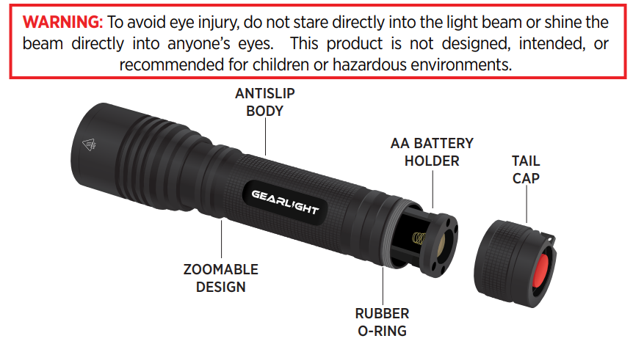
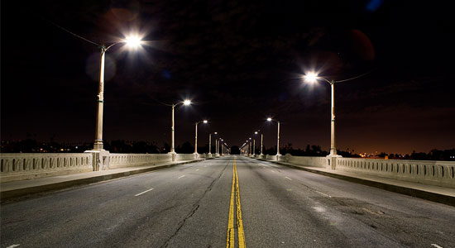
Eye Damage
How much radiation can our eyes tolerate?
Moonlight: 3 nits = .0004 mW/cm²
Neon Lamp: 8 nits = .001 mW/cm²
Fluorescent Lamp: 12,000 nits = 1.8 mW/cm²
Maximum Visual Tolerance: 50,000 nits = 7.3 mW/cm²
LED Streetlight: 500,000 nits = 73 mW/cm²
LED Tooth Whitener: 1,298,000 nits = 190 mW/cm²
LED Car Headlight: 200,000,000 nits = 29,283 mW/cm²
*Radiance is derived from peak luminance and at 555 nm
LED light shining directly into viewer’s eyes

Slide 9
Health Effects
Thyroid cancer - https://acsjournals.onlinelibrary.wiley.com/doi/abs/10.1002/cncr.33392
Breast cancer - https://theconversation.com/harvard-study-strengthens-link-between-breast-cancer-risk-and-light-exposure-at-night-75171
Prostate cancer - https://www.hindawi.com/journals/ije/2018/3271948/
Mood disorders - https://www.ncbi.nlm.nih.gov/pmc/articles/PMC5299389/
Premature births - https://news.ucdenver.edu/light-pollution-linked-to-preterm-births-reduced-birth-weights/

Slide 10
Discrimination
LED streetlights cause epileptic seizures, migraines, and psychological trauma
Illegal barriers to access violate the ADA
ADA liability
ADA Self-Evaluation Plan for people with light sensitivity disabilities
Specific persons harmed:
Mark Baker – autism – psychological trauma
MarieAnn Cherry – epilepsy – life-threatening seizures
John Moody – migraines – debilitating migraine headaches

Slide 11
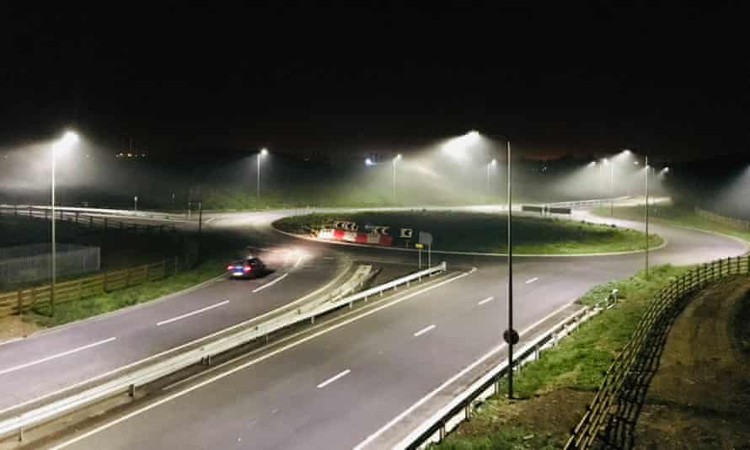
LED Environmental Damage
August 21, 2021 - First Estimation of Global Trends in Nocturnal Power Emissions Reveals Acceleration of Light Pollution - https://www.mdpi.com/2072-4292/13/16/3311/htm
Quote: We estimate the hidden impact of the transition to solid-state light-emitting diode (LED) technology, which increases emissions at visible wavelengths undetectable to existing satellite sensors, suggesting that the true increase in radiance in the visible spectrum may be as high as globally 270% and 400% on specific regions.
August 25, 2021 - LED streetlights decimating moth numbers in England
- https://www.theguardian.com/environment/2021/aug/25/led-streetlights-moth-england-eco-friendly-sodium-insect-decline
Quote: The abundance of moth caterpillars in hedgerows by rural roads in England was 52% lower under LED lights and 41% lower under sodium lights when compared with nearby unlit areas.

Slide 12
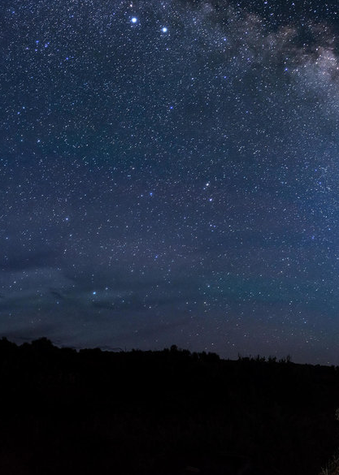
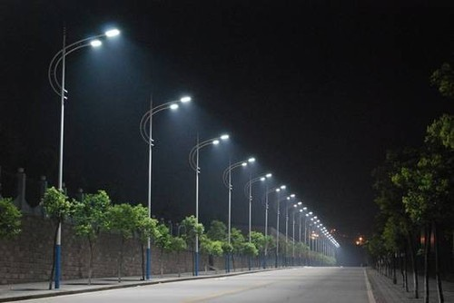
Natural Night Resource
Toxic, Dangerous, Expensive
Healthy, Safe, Free

Slide 13
Credits and Resources
Dr. M. Nisa Khan - Understanding LED Illumination and Derivation and Experimental Verification of the Near-field 2D and 3D Optical Intensities From a Finite-size Light Emitting Diode (LED) - https://ieeexplore.ieee.org/abstract/document/8879542
Alex Reyer – Light Measurement Handbook - http://www.dfisica.ubi.pt/~hgil/Fotometria/HandBook/luz.html
SoftLights.org - http://www.softlights.org/resources/

