Slide 1
Soft Lights Foundation
The Hazards of Light
Emitting Diode Products
www.softlights.org

Slide 2
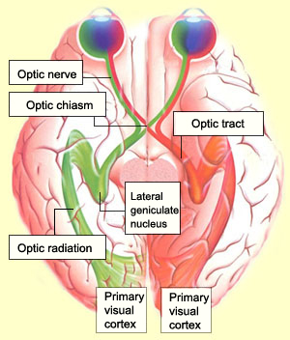
Visible Electromagnetic Radiation is Converted to Electrical Signals
Biological Expectations of Light:
Sunlight during the day
Starlight and moonlight during the night
Spatially uniform
Continuous
Reflected from an object
Low intensity
https://thebrain.mcgill.ca/flash/d/d_02/d_02_cr/d_02_cr_vis/d_02_cr_vis.html

Slide 3
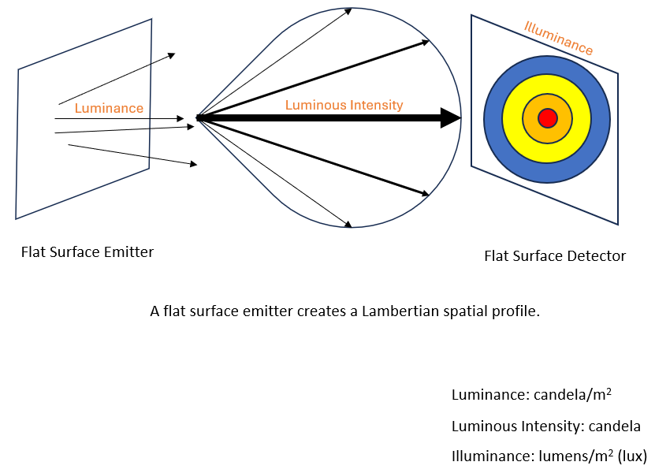
Flat Surface Emitter
Luminance Examples LED car headlight = 70,000,000 cd/m²
LED street light = 100,000 cd/m2
Maximum human comfort = 300 cd/m² Roadway surface at night = 0.3 cd/m²

Slide 4
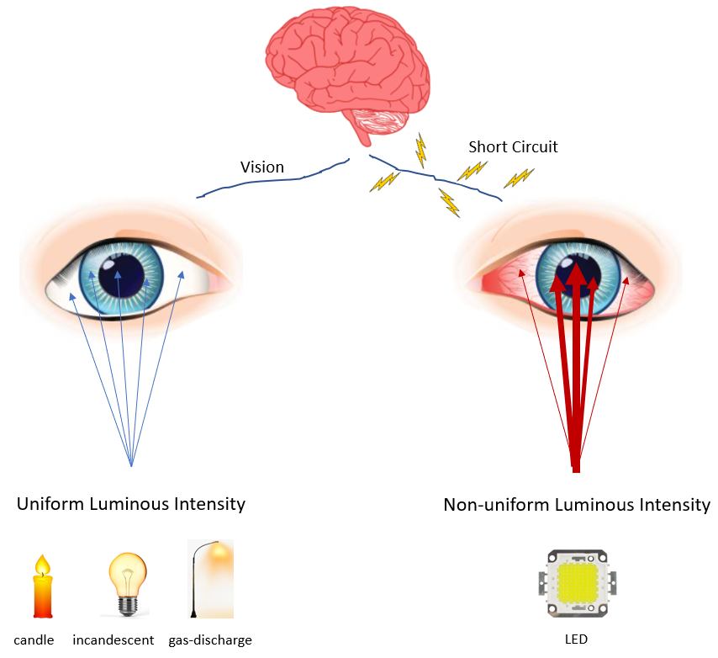
Curved vs. Flat Surface
Flat Surface LED Visible Radiation:
Extreme luminance
Spatially non-uniform
Directed energy beam
Blue wavelength
Square wave flicker

Slide 5
Adverse Health Impacts of LED Visible Radiation
Neurological
Optical
Circadian Rhythm
Seizure
Migraine
Anxiety
Panic Attack
Nausea
Brain Fog
Eye pain
Permanent eye cell damage
Macular degeneration
Loss of sleep
Diabetes
Heart disease
Prostate cancer
Breast cancer
Thyroid cancer
Mood disorders
Premature birth
Early mortality
Autism

Slide 6
Personal Stories of Harm
“I have been made ill from LEDs since 2007. It is more than a sensitivity; it is a disability. I am disabled by my environment, like so many others, and excluded from society.”
“LED-triggered seizures have left me with broken teeth, bruises and excruciating pain that lingers for days.”
“I immediately developed pain behind my left eye, became pale and nauseated and rapidly developed a migraine.”
“Every day I would come to work, and these unnatural lights would shine into my eyes, terrorizing me.”
“Strobing LED lights are becoming so common on utility vehicles, and they actually cause me to go into a completely overloaded state where I can’t think straight.”
“Since these LED headlights have been allowed, my life has been destroyed and my world turned upside down.”

Slide 7
Lack of Regulations
1968 Radiation Control for Health and Safety Act: 21 U.S.C. 360hh – 360ss
No FDA performance standards
No restrictions on luminance, dispersion characteristics, spatial non-uniformity, spectral power distribution, or square wave flicker
No regulations by any federal agency, including FDA, DOE, DOT, NHTSA, FMCSA, OSHA, CPSC, Access Board, FAA, or EPA
No regulations for LED vehicle headlights, LED streetlights, LED General Service Lamps, LED strobe lights, LED indicator lights in appliances, LED flashlights, LED bicycle lights, etc.
Government and industry have ignored the luminance metric.
Government is not collecting the reports of harm from LED exposures.
DOE makes two false claims: 1) LED light and incandescent light have the same characteristics; 2) There are no adverse health impacts from LED visible radiation.
LEDs are not energy-efficient, just low-quality visible radiation.

Slide 8
Soft Lights Foundation Regulatory Efforts
June 12, 2022 – Petition FDA-2022-P-1151 to publish performance standards for LED products as mandated by 21 U.S.C. 360ii.
December 24, 2022 – Petition to DOE to Repeal 45 Lumen/watt Final Rule ignored. DOE Office of Inspector General case 32-0319-C.
January 22, 2023 – Petition FDA-2023-P-0233 for LED flashing lights.
September 7, 2023 – Petition FDA-2023-P-3828 for LED headlights.
September 11, 2023 – Petition FDA-2023-P-3879 for LED street lights.
September 27, 2023 – NHTSA Request for Interpretation Letter - LED Headlight authorization.
November 26, 2023 – Petition to FTC to require luminance metric on LED product packaging.

Slide 9
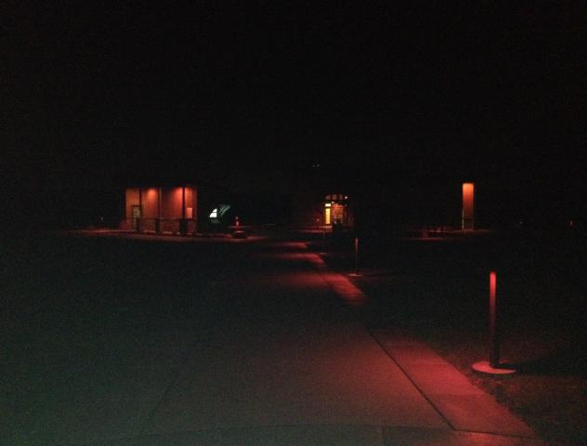
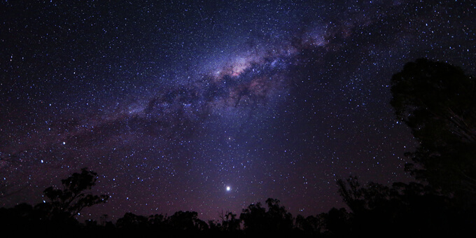
Recommendations
FDA must publish performance standards for LED products.
Restrictions on Luminance.
Restrict blue wavelength light.
Protect the starlight, moonlight, and absence of sunlight as fundamental resources.
Artificial light is a pollutant.
Protect those who are most sensitive to LED visible radiation.
LED Streetlights are unnecessary and harmful.
Prohibit LED flashing lights.
Good
Best

